Slide 1
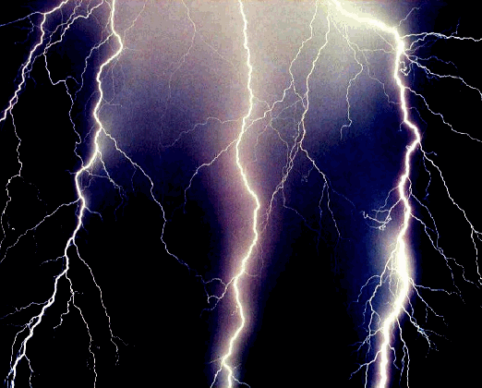
ELECTRICAL safety
Don’t Be Shocked

Slide 2
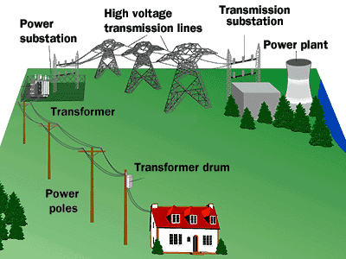
Electricity 010
Electricity generated at the power plant flows through:
Transmission Substation
High Voltage Lines
Substation
Local Distribution Lines

Slide 3
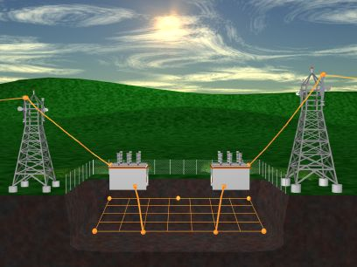
Electricity 010
At the Power Generating Station there is a large
GROUNDING GRID
This is for the return
EARTH GROUND

Slide 4
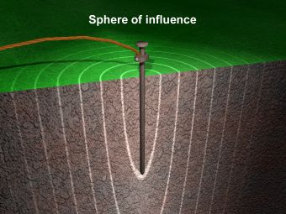
Electricity 010
Rule #1
Electricity will always follow the path of least resistance to ground
Electricity will always travel from a higher resistance (ground state) to a lower resistance (ground state)

Slide 5
Electricity 010
To Complete the Circuit back to the Power Plant
The House Ground
Completes the Connection
If You Do Not Have a
Ground The Electronics in
The House Will Not Work
Notes:
Went to a house that said the cable was burning out their TVs. Used an outlet checker and all the outlets blinked ‘ NO GROUND’’ The house was grounding out through the cable, When the cable was disconnected at the ground block the house went DARK. The ground conductor rotted off the ground rod.

Slide 6
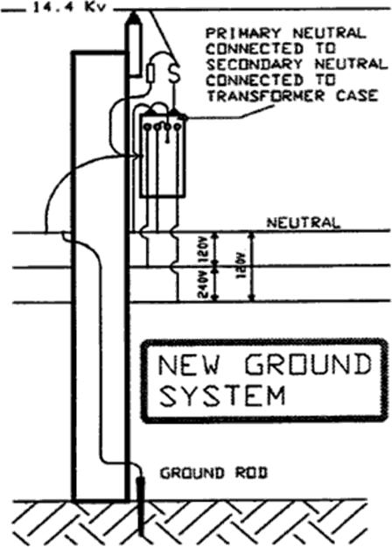
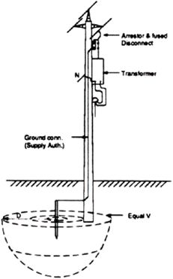
Electrical safety
GROUNDING
MGN to Vertical Ground
Provides a Low Impedance Path for Stray Current
MGN Absorbs the Unbalanced Energy Between the 3 Phases
Stray Current is Dispersed to Ground
Notes:
This is why you check Vertical grounds and down guys. Remember the soil closest to the ground rod will be more saturated the future from the stake will have a lower resistance, remember rule #1.

Slide 7
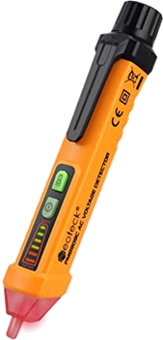
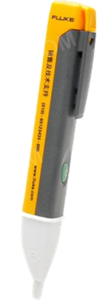
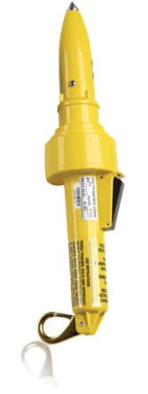
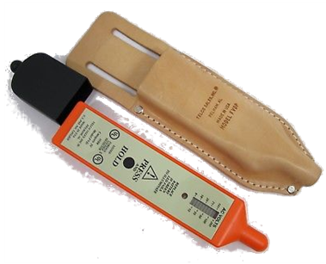
Electrical safety
Foreign Voltage Detector
Always Use a Non-Contact Voltage Detector
You Cannot See Stray Voltage
Know the Type of Detector You are Using
Some Will Only Detect the Magnetic Flux in a Closed Circuit
They Will Not Read a Hot Wire if it is Not in Grounded Circuit

Slide 8
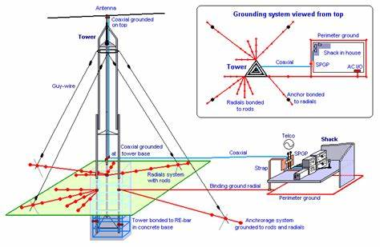
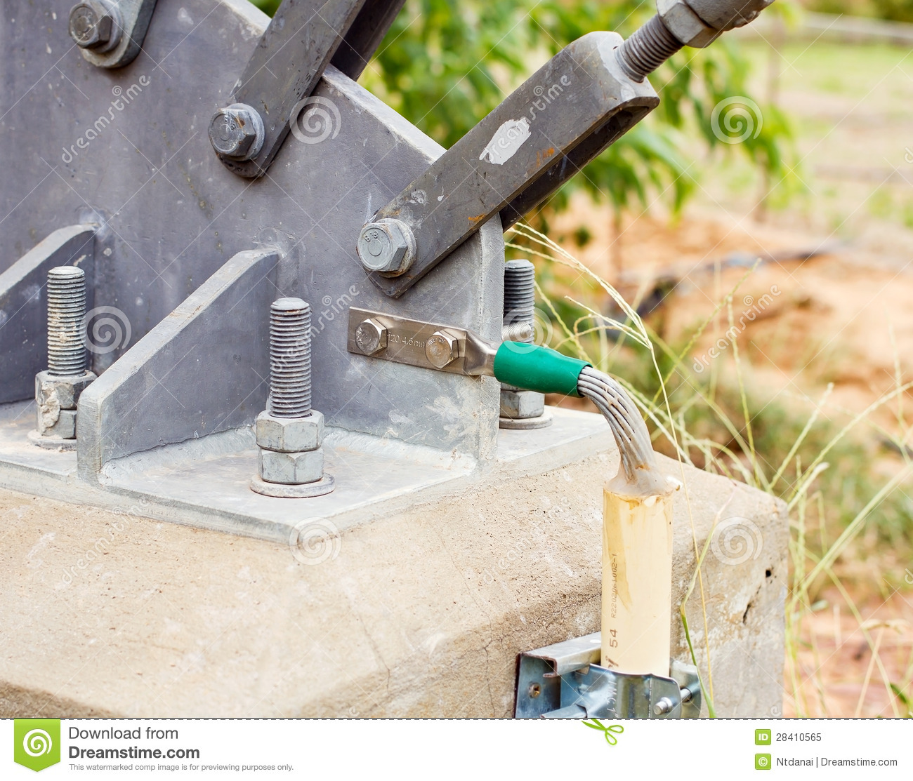
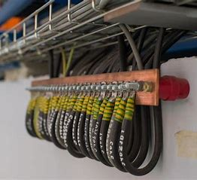
Wireless Safety
Tower & Site Grounding
Phone Tower
BUSS

Slide 9
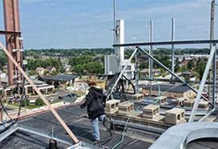
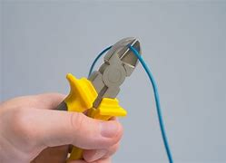
Wireless Safety
Roof top Safety Has Its own set Of Hazards
Wires All Over the Roof
You Must have Barricades or Fall Protection if You are Within 15’ of the Edge
When Cutting Electrical Wires
Cut One Conductor at a Time

Slide 10
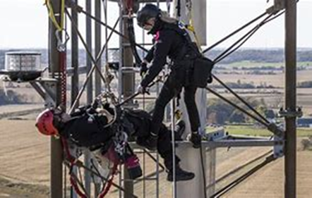
Wireless Safety
All tower Workers Must be Certified for Tower Rescue
All Tower Workers Must be Trained and Certified for First Aid and CPR

Slide 11
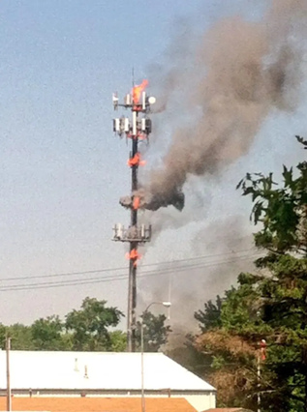
Wireless Safety
Equipment Can Fail and Catch Fire
Burning Equipment can Cause the Tower to Collapse

Slide 12
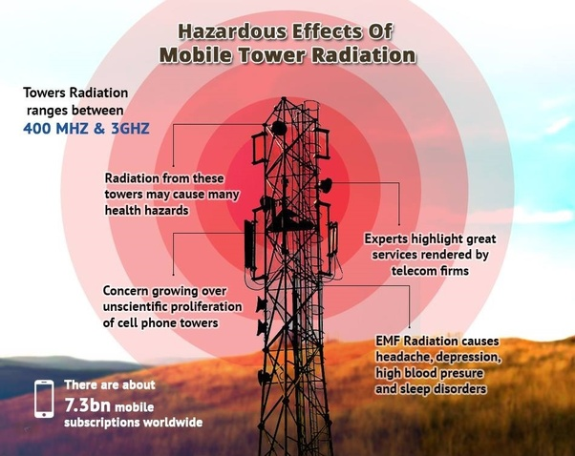
Tower Workers Must Be Trained in the Hazards of RF Exposure
Contacting an AM Tower & Ground Can Cause Serious
RF Burns

Slide 13
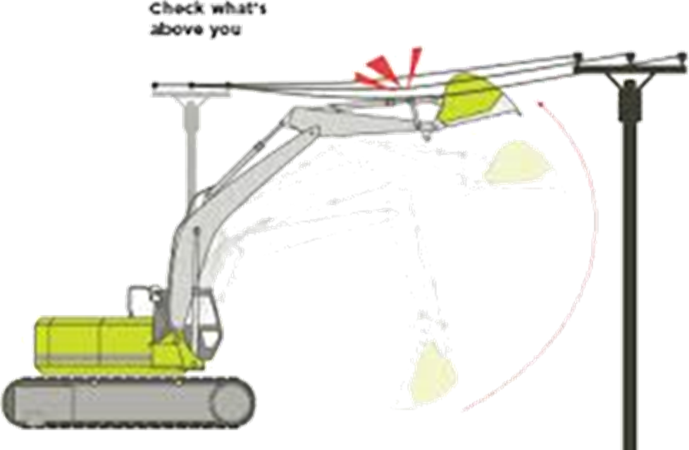
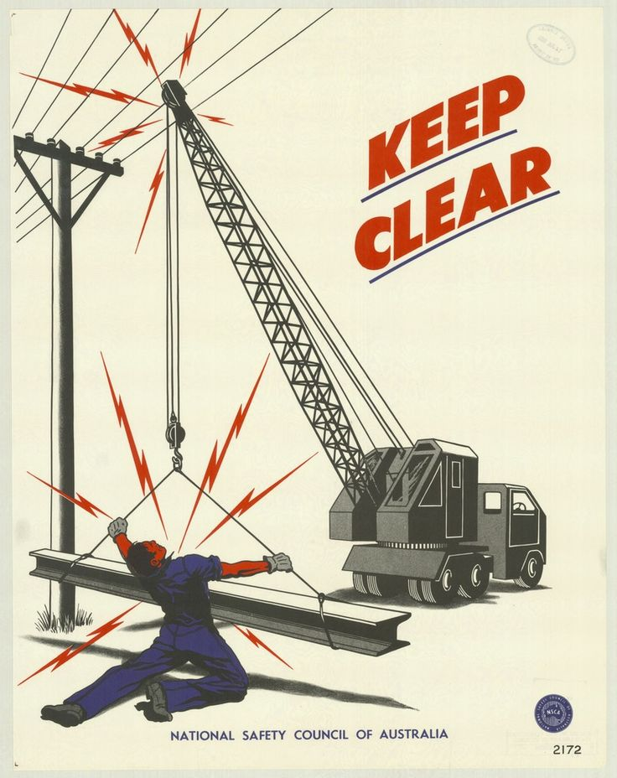
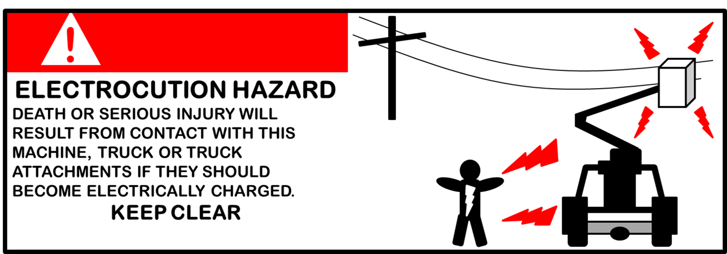
Equipment Clearance
Notes:
Remind everyone to check the clearance of all equipment from energized lines. They need to warn people to stay away from the equipment due to the possibility of the equipment becoming energized due to induced voltage.

Slide 14
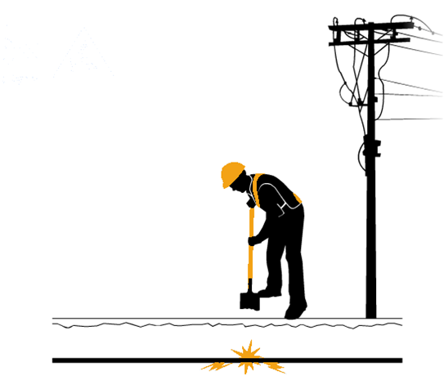
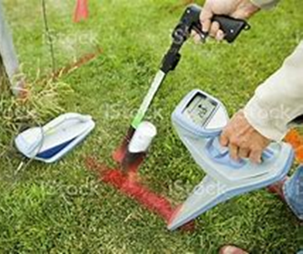
Underground Safety
ALL UTILITIES MUST BE MARKED BEFORE DIGGING or DRILLING
With Temperatures Rising the
Ground is Thawing
Making Soil Wet and More Conductive
Shovel Contacts
Energized Line
Drill Head Makes
Contact

Slide 15
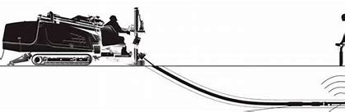
Underground Safety
If The Strike Alarm Goes OFF
Stop Drilling
Stay on the Drill
Call The Utility
Do Not Pull Back this May Cause More Damage
Wait for the ALL Clear from the Utility Before Getting Off the Drill.

Slide 16
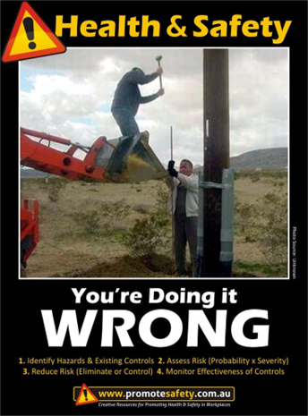
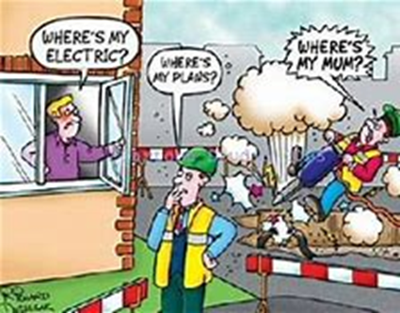
Check the Locate Marks Before
Driving in Ground Stakes
Setting Ped Stakes
Setting Vaults
Notes:
What is wrong with this picture

Slide 17
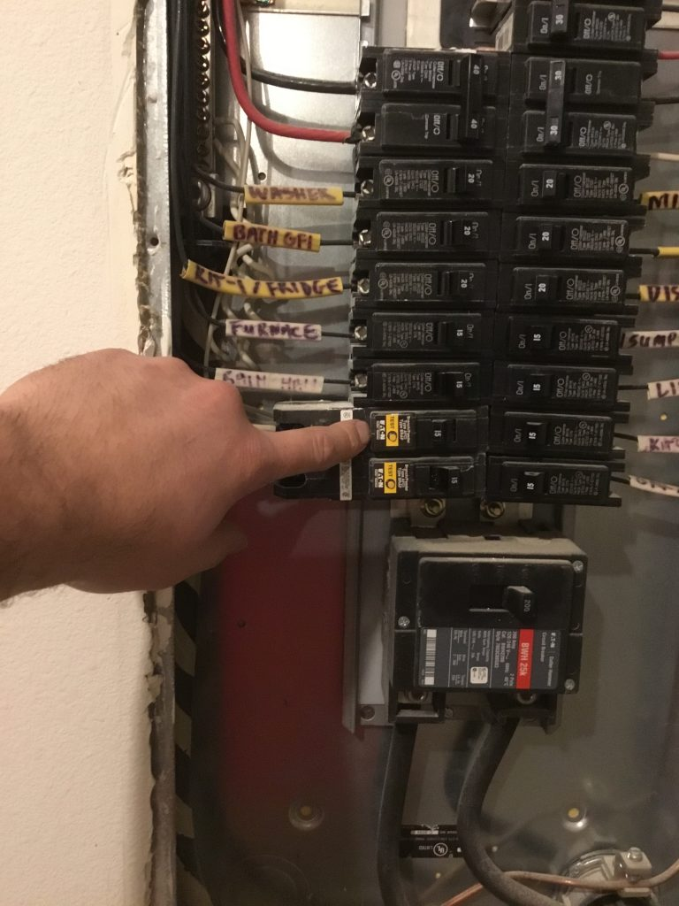
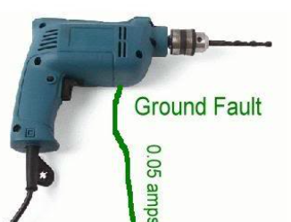
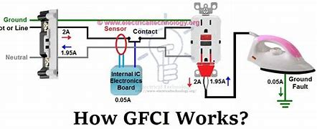
How GFCI Works
A GFCI Compares the Current Going to the Load and the Current Returning
If there is More Than 0.05 Amp Difference the GFCI Will Open the Circuit
This Happens in Less Than 1/40th of a Second
Notes:
On the right we have GFCI installed in a panel. On ALL worksites electrical tools and equipment should be plugged into a GFCI circuit.

Slide 18
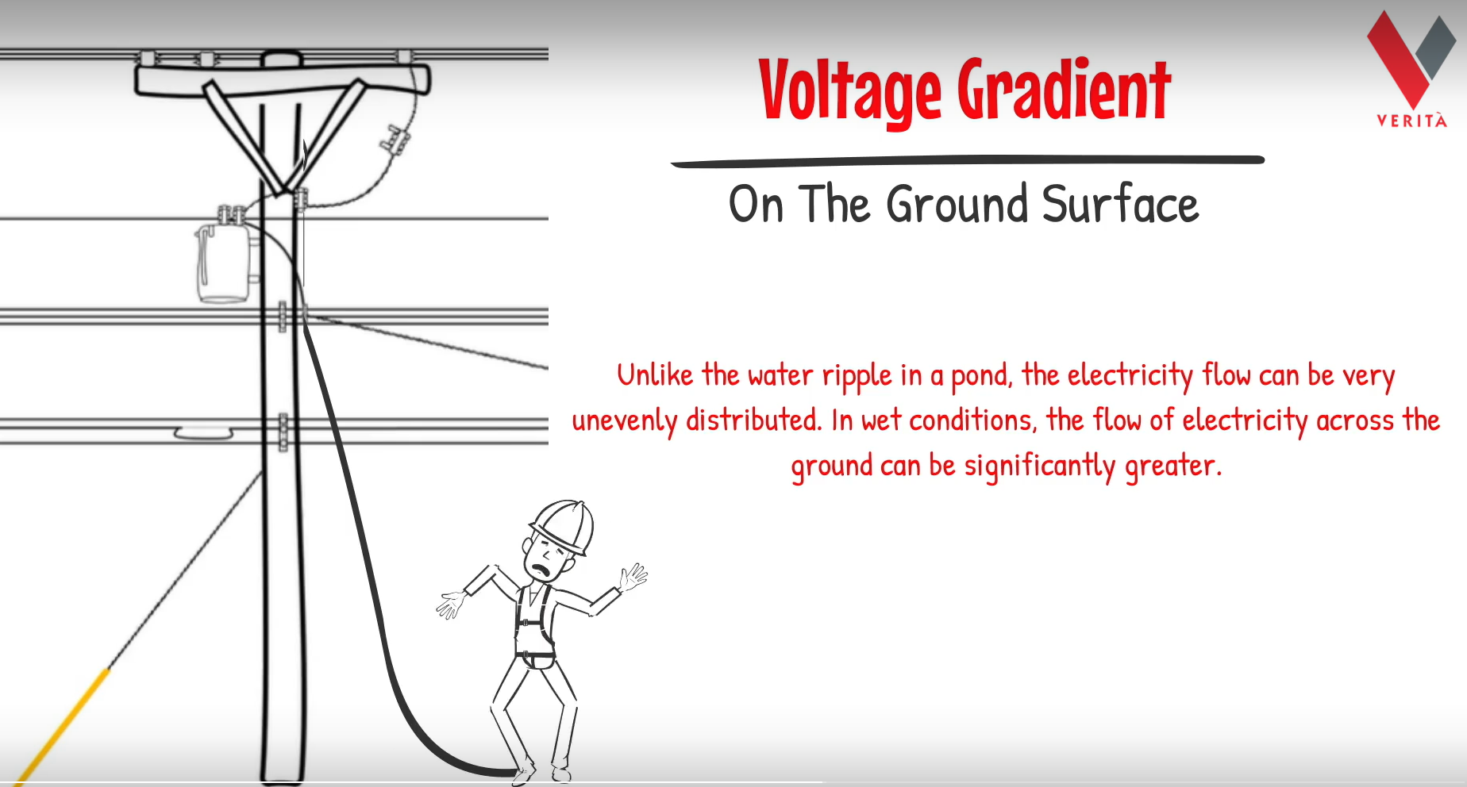
Direct Contact
Notes:
After a Storm or Vehicle accident ALWAYS assume the line is HOT, until you can check with a FVD

Slide 19
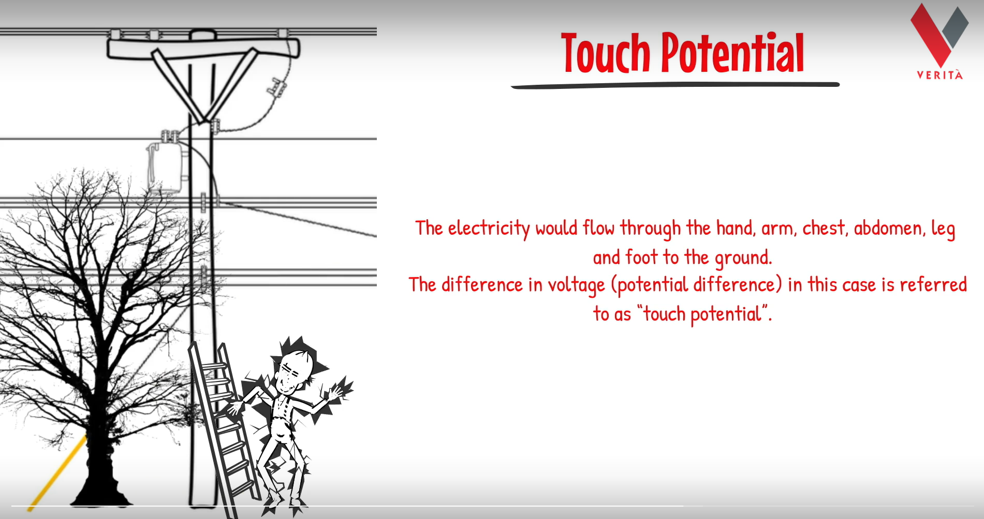
Indirect Contact

Slide 20
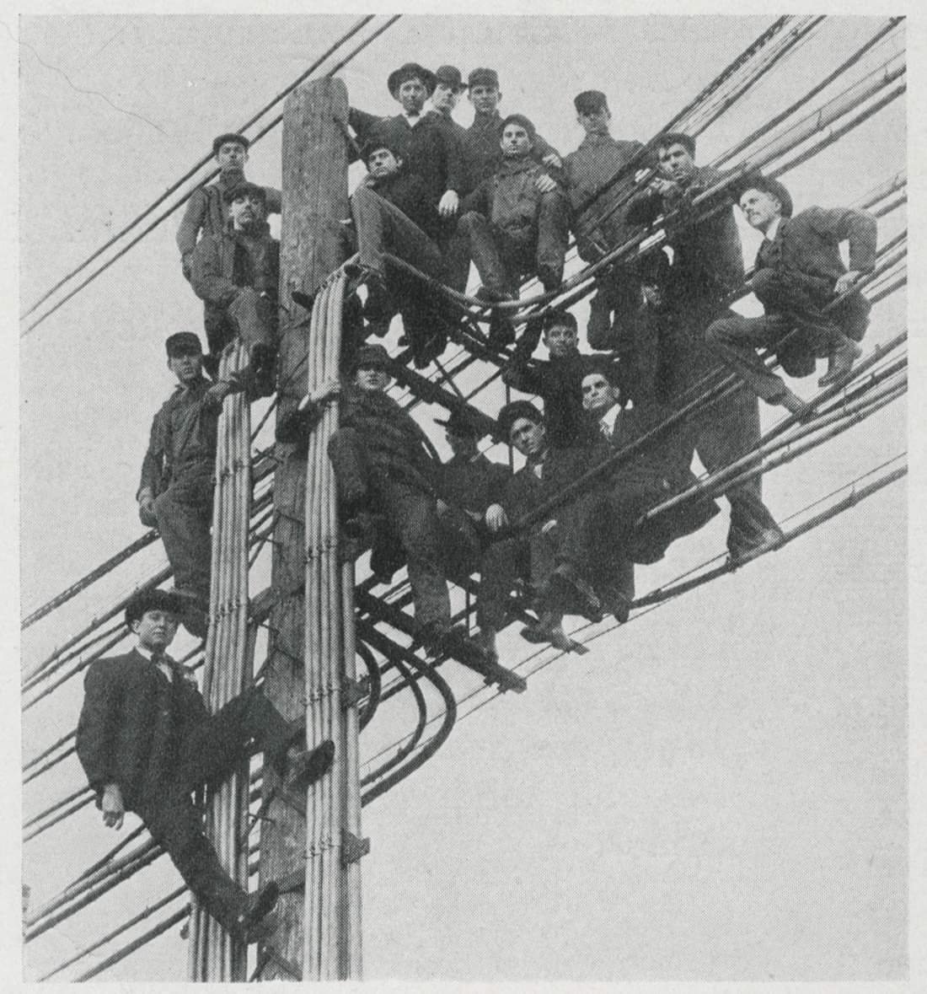
Aerial Wired Safety
PPE Must Be Worn at All Times
  Hard Hat
  Safety Glasses
  Vest
  Gloves
  Boots
Maximum Approach Distance
  24” to ANY ELECTRICAL CONDUCTOR
Use an FVD Before Contacting Pole or Strand

Slide 21
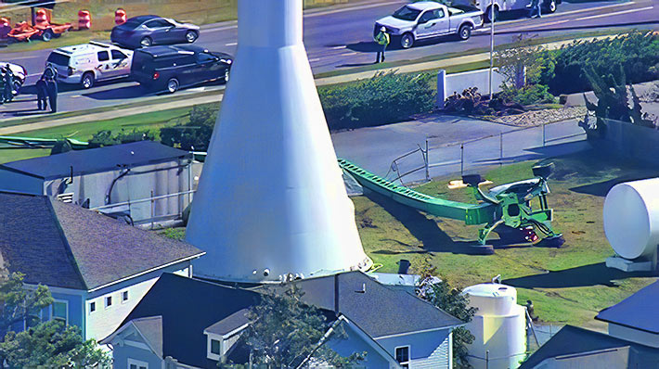
Aerial Lift Safety
Always Make sure the Lift is on Level Ground, Outriggers Extended
If so equipped.
This Lift was Rated for 141’
Working Height and 600 lb. load.
At 120’ a Gust of Wind of 39 MPH Caused the Lift to Tip Over and Become entangled in the Electric Lines.
Operator Manual Should have a
Graph showing Wind Speed and
Maximum Working Height

Slide 22
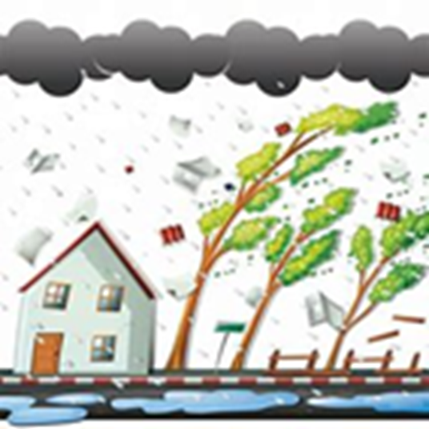
Aerial Lift Safety
Remember During Storms or High Wind situations, Your Bucket and the Poles are Going to Sway
Trees Can Sway into Power Lines
Trees under the Wind Stress can Break and Bring Down Power Lines.
Do Not Operate a Bucket or Climb a Ladder
If Wind Speed is ≥30 MPH Continuously

Slide 24

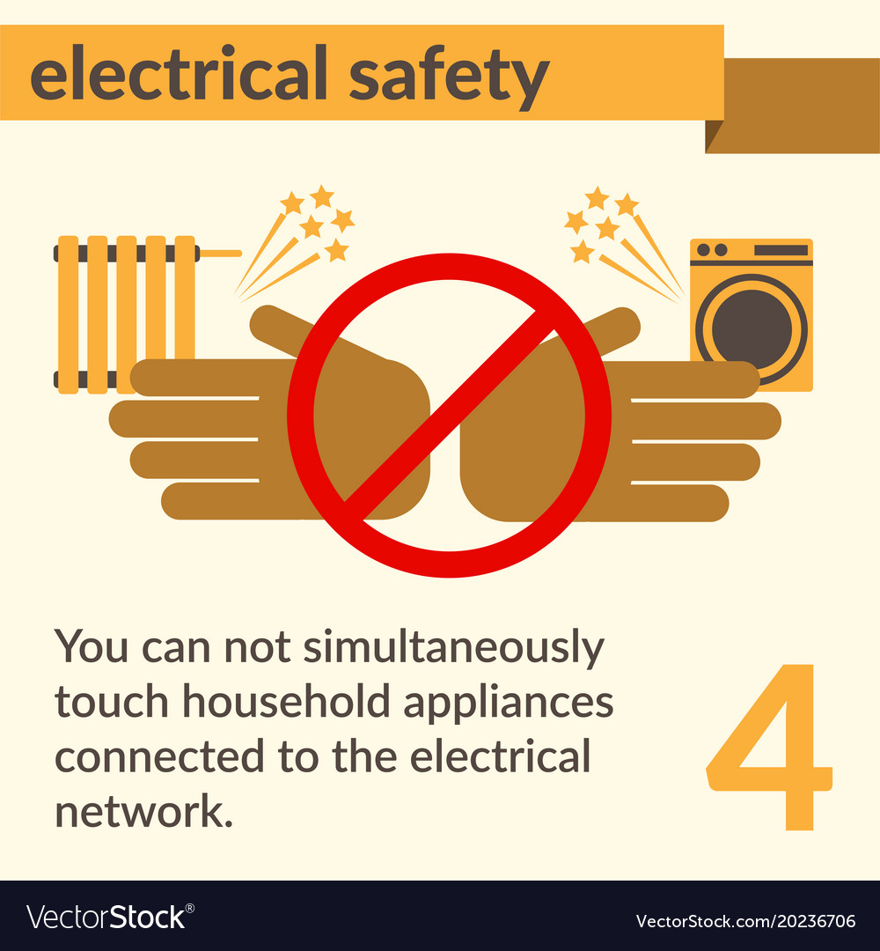
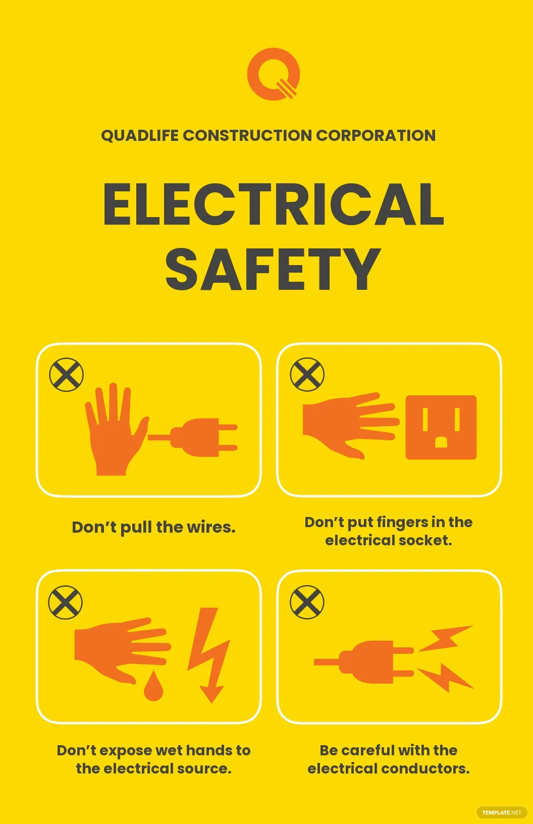

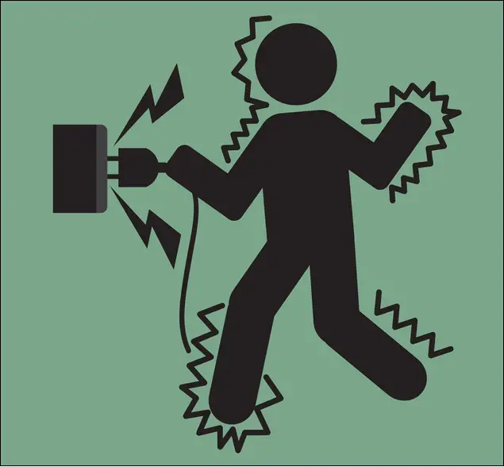
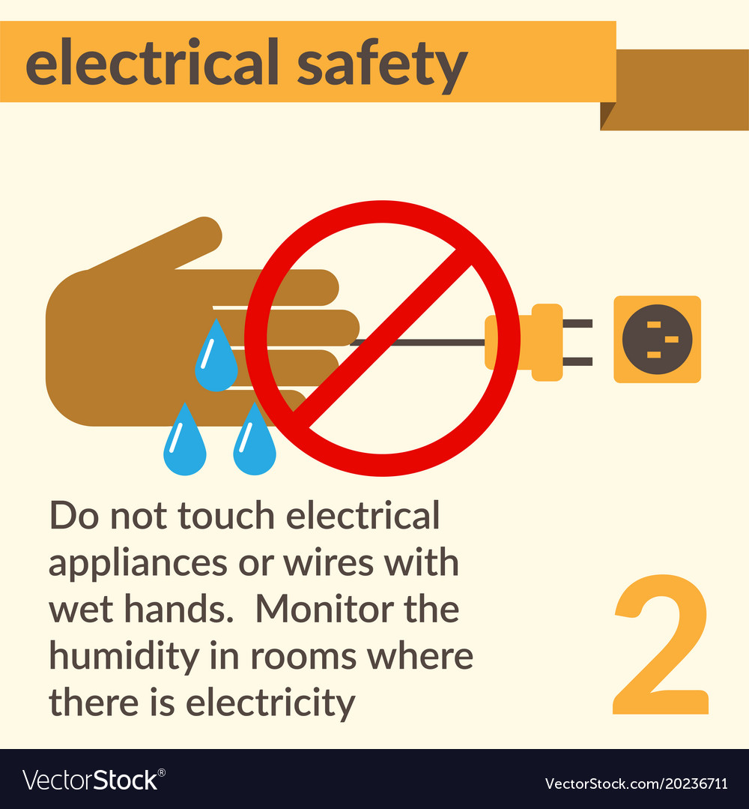
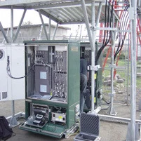

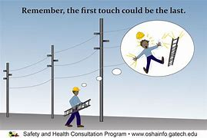
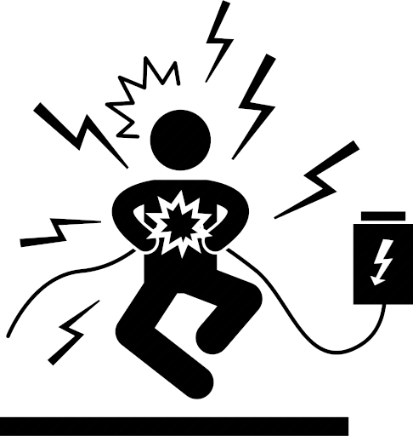

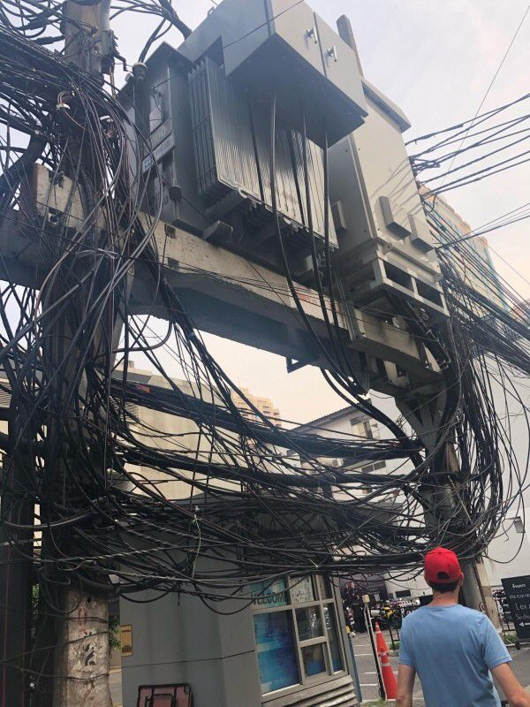
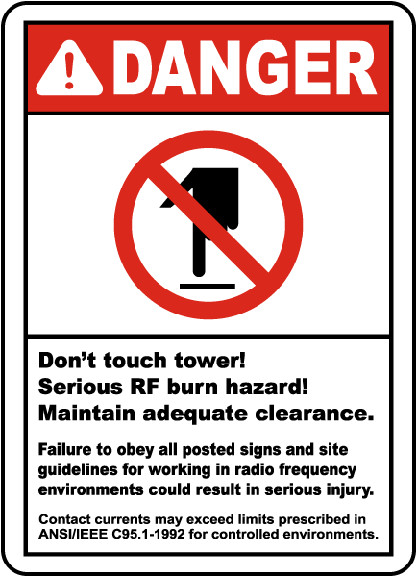
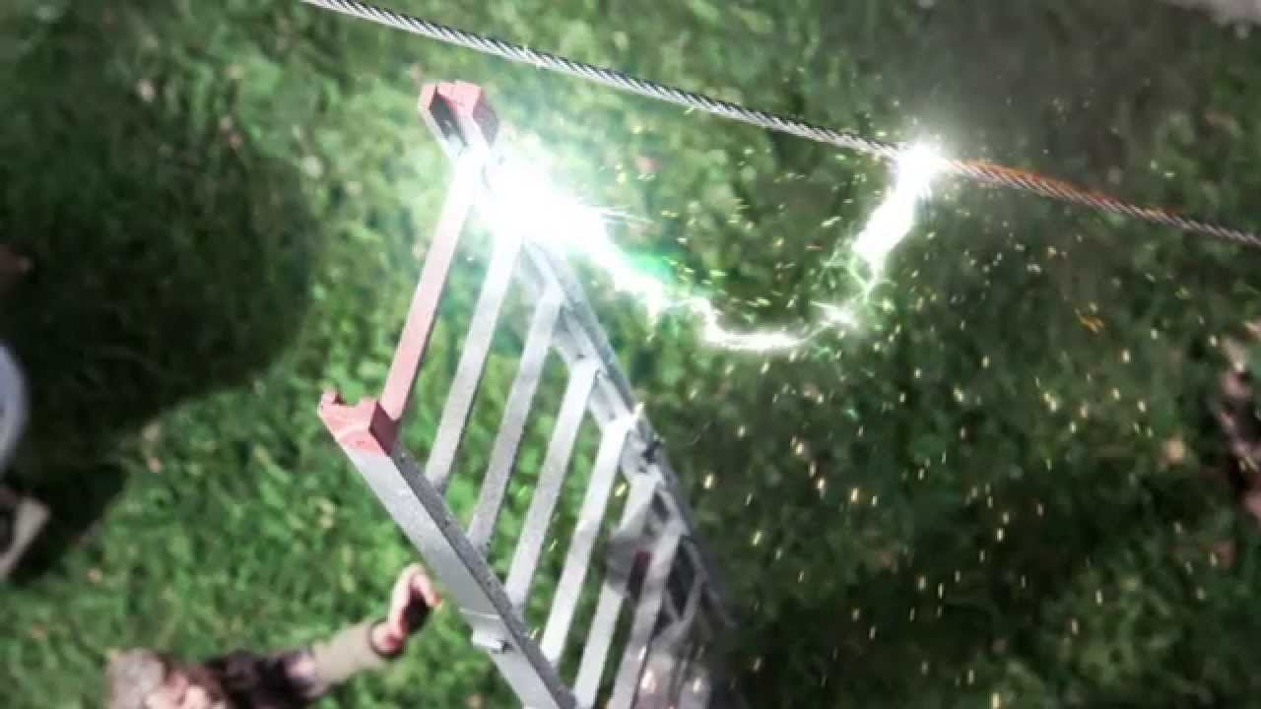
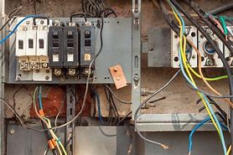

Slide 25



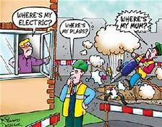
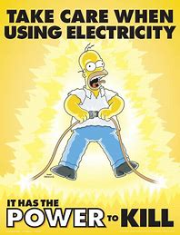

Slide 26





